Slide 1
Denver City Sorting Tool
Samuel Rosean

Slide 2
Homeowner Problem
Imagine a prospective homeowner
Which neighborhood to choose?
A tool to sort Denver neighborhoods by business type and density thereof
A boon to your realty business
3. An increase in customer satisfaction

Slide 3
The Necessary Data
Geodata from Open Soft Data
Zip Code for each neighborhood
Latitude and Longitude values for each zip code center
Business data from Foursquare
Business type
Amount of each business type in each zip code

Slide 4
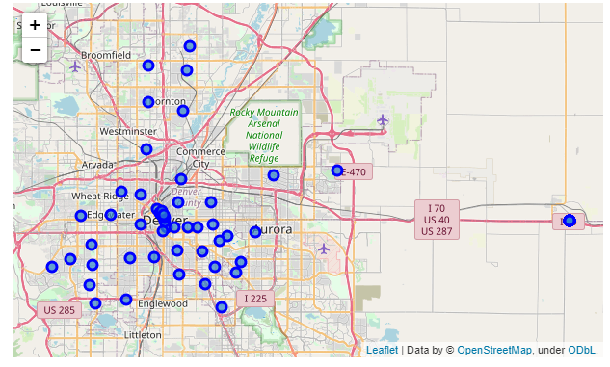
Cleaning The Data
Open Soft Data - Geodata
Remove non-Denver data points
Remove data irrelevant to our problem (Timezone, Daylight Savings Code)
After plotting revealed Airport Zip Codes, remove those

Slide 5
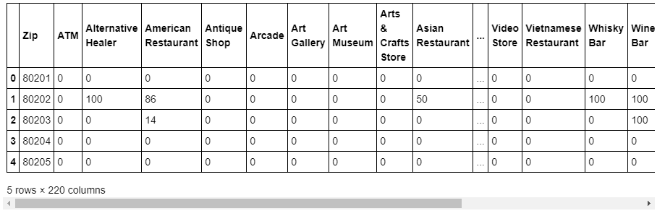
Cleaning The Data
Foursquare Data
Collapse all business data into a count for each type based on the neighborhood
Normalize this value to be a number divided by the maximum possible count for that business type
Convert that normalized value into an integer value out of 100 to be mapped to a color space

Slide 6
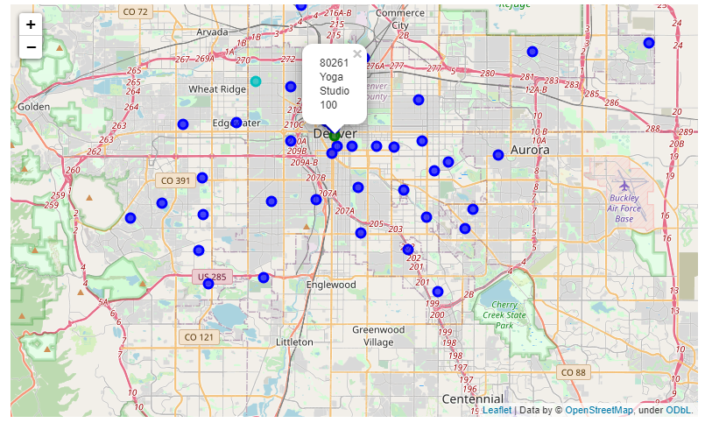
Mapping Data Based on Business Type
Have the user select business type
Map these values on a heat scale from blue (lowest) to green (highest)

Slide 7
Conclusions and Future Directions
The tool works admirably considering the limitations of its graphical and data possibilities. Even if slightly rudimentarily it provides the ability to see what kind of businesses are distributed through the city, and where they are most common.
Graphical Improvements
Postal code boundaries
Better color map to differentiate between small differences and not allow outliers to define visuals
Data Improvements
Pull business based on zip code not radius.
Pull more data

